Slide 1
Real Time Kinematic(RTK)
Abhishek Vandadi (A20426749)
Nital Bansode (A20427196)
Amitdeb Prasad Bhattacharya (A20402789)
Karthik Mahesh (A20383027)

Slide 2
WHAT IS REAL-TIME KINEMATIC(RTK)?
Real-time kinematic (RTK) is a positioning technique used for applications that require high accuracy for estimating positions. It is used to enhance the precision of position data derived from satellite-based positioning systems (global navigation satellite systems, GNSS) such as GPS, GLONASS, Galileo, and BeiDou.

Slide 3
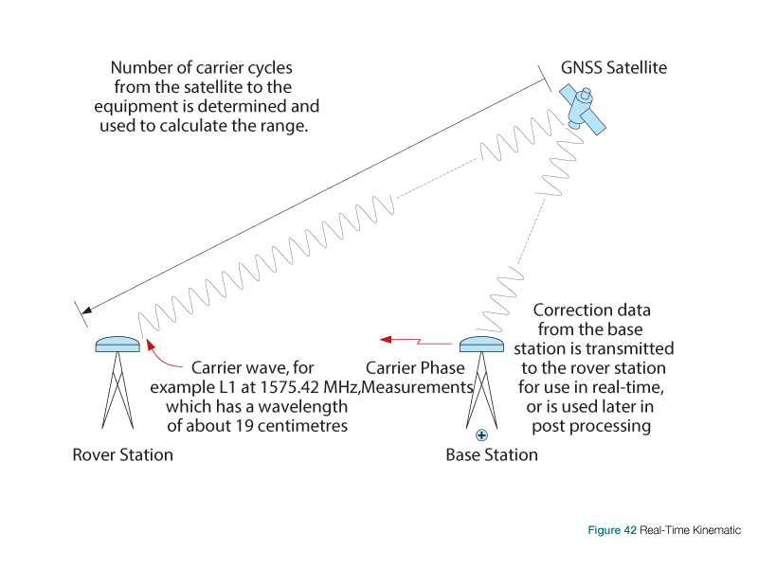
HOW DOES RTK WORK?
RTK consists of a base station, one or several rover users, and a communication channel with which the base station transfers correction data to the user.

Slide 4
HOW DOES RTK WORK?
When RTK uses a fixed base station and a rover station, the base station transmits correction data to the rover.
Range b/w satellite & receiver = Number of carrier cycles b/w satellite and rover * carrier wavelength
The ranges obtained can still contain errors such as satellite clock errors.
To handle them ambiguity resolution is used.

Slide 5
Ambiguity Resolution
Ambiguity resolution techniques are classified into 3 categories:
1) Ambiguity resolution in the measurement domain.
2) Search technique in the coordinate or position domain.
3) Search technique in the ambiguity domain.

Slide 6
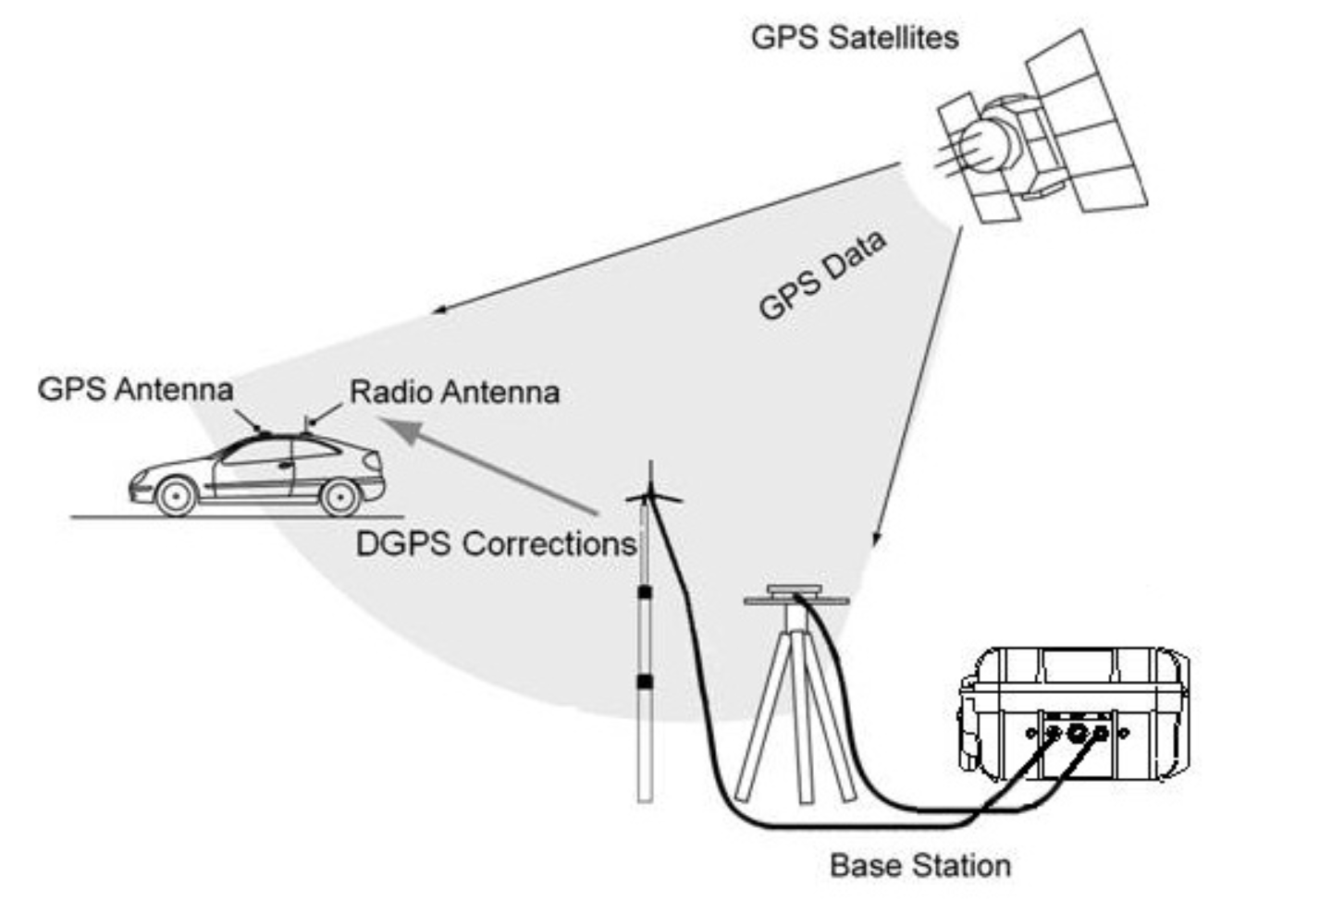
How Does it improves GPS?
The accuracy of GPS signals can be improved by using a fixed base station which wirelessly sends corrections to a moving receiver.
If only GPS is used it would be difficult to trace accurate location, so RTK technology is used. Thus RTK fixes error in location detection by using ambiguity resolution.

Slide 7
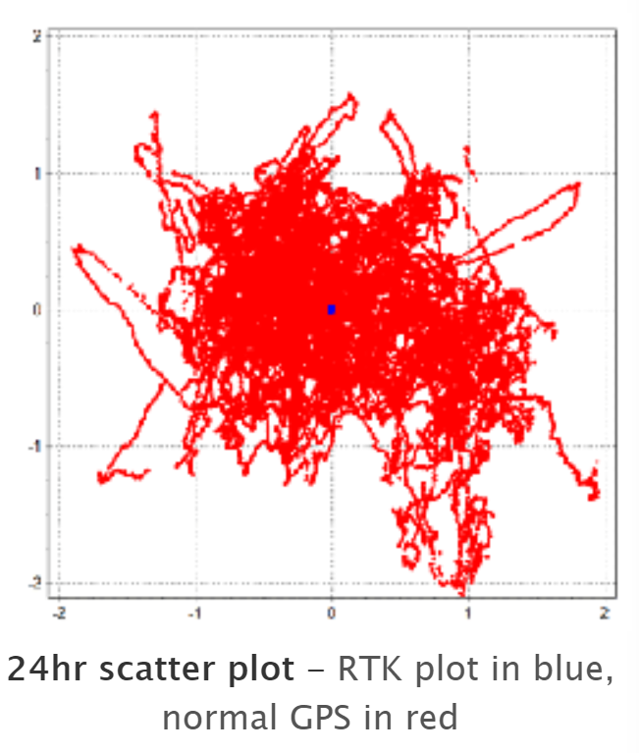
How Does it improves GPS?
Basically stand-alone GPS traces the location with error as shown in scatter plot with red mark which indicates that the result is having some noise which is not accurate.
RTK shows accurate result and is identified with blue in the scatter plot which gives pin point location.

Slide 8

How Does it improves GPS?
The base station can also be on a moving vehicle, so the corrections needs to be sent out at the sample rate of the receiving GPS engine, and the accuracy is slightly reduced if compared to fixed base station case but it maintains its accuracy well enough.

Slide 9

How Does it improves GPS?

Slide 10
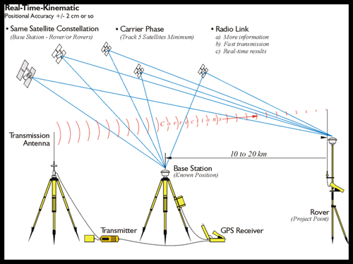
Pros
RTK improves the location accuracy to centimeter level.
With radio link, more information could be transmitted in lesser time.
Calculated positions are available directly and ambiguity values resolved.
Provide protection from radio interference.

Slide 11
Cons
Roving station must be within the range of base station with tolerance of 10s.
Requires frequencies from two constellations in order to work quickly.
Requires to track 5 satellites.
Ambiguity resolution is required for high precision.
Base station and mobile station requires clear line of sight.
Radio interference and other environmental factors affects accuracy.
Accurate base station coordinates are required.

Slide 12
What are the use cases?
Typical Modes of Operation for a GNSS RTK Receiver:
Traditional RTK using Fixed Base and Moving Rover
Agriculture - Precision Agriculture Robots
Machines in large construction projects - Commercial Drones
Traditional RTK using Moving Base and Moving Rover
Autonomous vehicles.
Ships or Boats - Direction
Aircraft

Slide 13
Use Cases
Stand-alone RTK receiver outputting raw GPS / GNSS Data
Raw GPS / GNSS data refers to the raw or unsolved measurements that a receiver solves for by listening to the satellite signals from GPS satellites.
scientific research
weather forecasting
Stand-alone RTK receiver outputting Standard Position Solution (SPS)
Forest areas
To maintain timing in many infrastructures such as Money transfer, Telecommunication networks,
electric power distribution, military.

Slide 14
References
https://www.novatel.com/an-introduction-to-gnss/chapter-5-resolving-errors/real-time-kinematic-rtk/
https://en.wikipedia.org/wiki/Real-time_kinematic
https://www.e-education.psu.edu/geog862/node/1845
https://learn.sparkfun.com/tutorials/what-is-gps-rtk/all
http://gnss-fantastic.eu/use-case-scenarios-rtk/
https://www.researchgate.net/publication/233966784_Performance_of_RTK_Positioning_in_Forest_Conditions_Case_Study
https://www.spirent.com/-/media/brochures/positioning/testing-gnss-real-time-kinematics.pdf
https://support.swiftnav.com/customer/en/portal/articles/2628573-gnss-rtk-use-cases-and-applications
https://www.ncbi.nlm.nih.gov/pmc/articles/PMC6068940/

Slide 15
Questions?

